Slide 1
Clubs And Events Management system
OOPs Project
Presented to :
Dr Mamta Juneja
Associate Professor
UIET Chandigarh

Slide 2
Team Members
Aryan Singh Dhiman
Eshita Negi
Gitansh Sehgal
Gourav Chahal
Hargun Kaur

Slide 3
Features Of This Project
Menu for information on Clubs
Menu for Club Recruitments
Menu for Organizing Club Meetings
Menu for Organizing Events

Slide 4
Why We Chose This Project
When a new batch of students enter, they don’t know much about the committees and it becomes difficult to decide which clubs to join or where their interests lie.
It would be better if we have a management system for the clubs and committees in UIET which the students as well as club heads can access.
Would be helpful for both students who wish to join a particular club as well as for club heads when they want to make any changes about information or to announce any recruitment dates, an event or a meeting.
It would provide one portal to organise clubs and events which otherwise is a cumbersome process.
It is easy to use as we have separate menus for information on clubs, recruitment dates, organising club meetings and for organising events.

Slide 5
Implementation (similar for every menu)

Slide 6
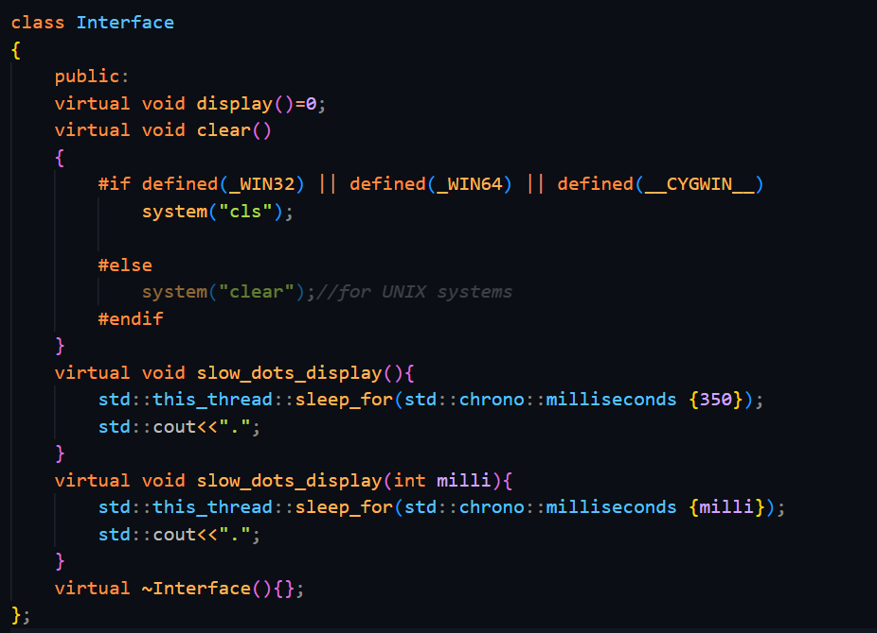
Menus
Each Menu is a class which is derived from a base abstract ‘Interface’ class.
The ‘Interface’ Class has four functions:
A pure virtual function display.
A virtual function clear.
A virtual function slow_dots_display.
An overloaded slow_dots_display function.

Slide 7
Interface
ClubMenu
EventMenu
AdminMenu
ClubInfoMenu
ClubMeetingMenu
ClubRecruitmentMenu
AdminEventMenu
MainMenu
AdminClubMeetingMenu
AdminClubInfoMenu

Slide 8

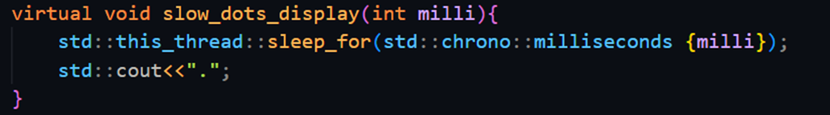
IO Formatting
We have used setw() and setfill() IO manipulators in our display() functions that we inherited from Interface class.
We have also used <chrono> and <thread> library to display … in a manner in which they are displayed with a delay.

Slide 9
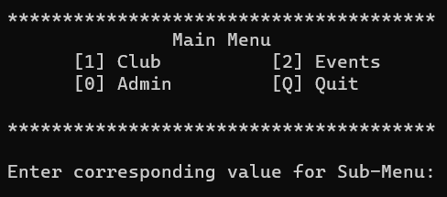
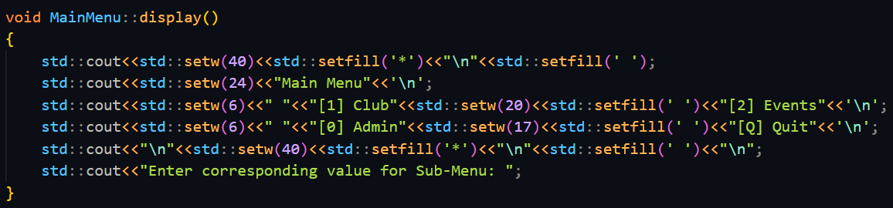
Main Menu

Slide 10
Encapsulation
The details of clubs and events are encapsulated using classes (e.g. Club class, Event class, Meeting class, Recruitment class)
Club
Name
Convenor
Event
Heading
Date
Description
Co-convenor
Social Media Id
Description

Slide 11
File Handling
Taking the example of events, the details of events are written in “event.txt” file.
The three members(heading, date, description) are arranged in the file successively.
The three lines of the file are read at once and used to construct an Event object.
The newly created Event object is pushed in a std::vector which is used for further operation.
After performing the necessary operations the file is truncated and the members of the objects in vector are put back in the same order in which they were read (using operator overloading).

Slide 12
event.txt
Heading1
Date1
Description1
Heading2
Date2
Description2
temp_event
temp_event
temp_event
Heading1
Heading2
Date1
Date2
Description1
Description2
event_holder (std::vector<Event>)
[0]Heading1
[1]Heading2

Slide 13
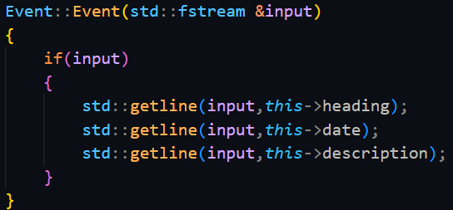
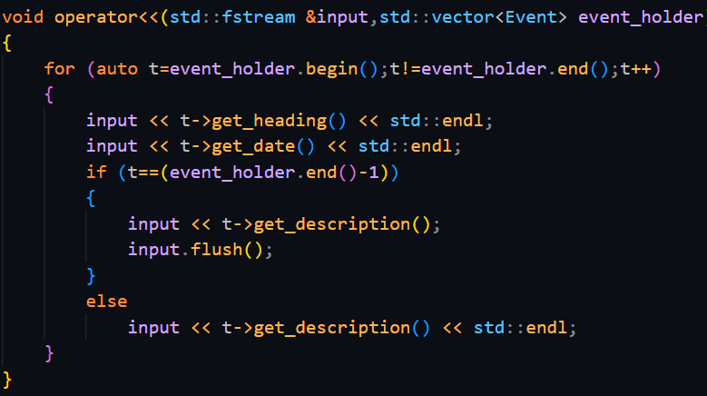
Reading from file
Writing to file

Slide 14

Use of Standard Template Library
Std::vector has been used to organize and temporarily store objects.
Std::vector’s push_back() method has been used to add objects to the vector ,at() method to access the objects , end() method to check for end of vector and erase() method to delete object in the vector as requested
Iterators have been used to access the elements iteratively.

Slide 15
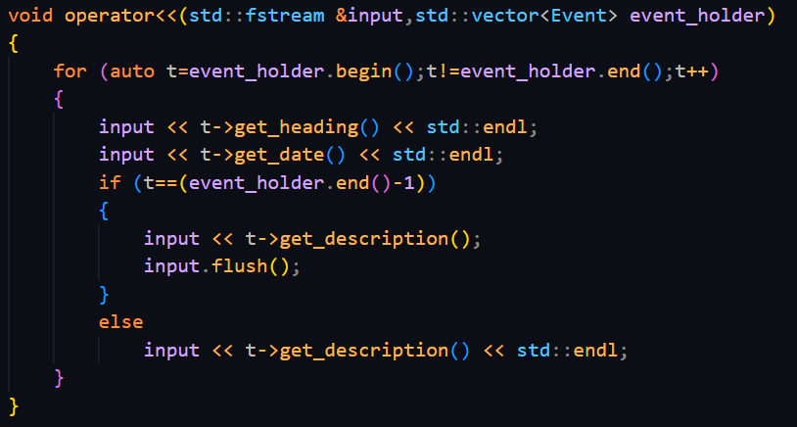
Operator Overloading
The stream insertion operator(<<) has been overloaded to write the contents of the ‘event_holder’ and ‘club_holder’ vector to the file.
Using an iterator we go through each object in the vector and call the getter methods to write the members of the object to the file.
A new line is inserted after writing every member except for the last member of the last object.

Slide 16
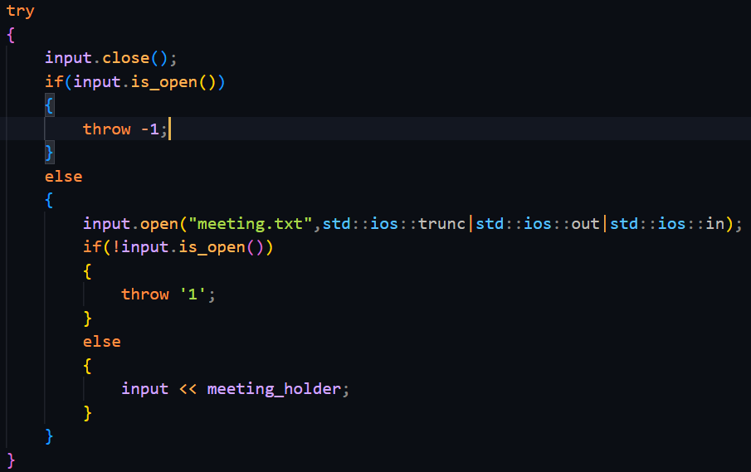
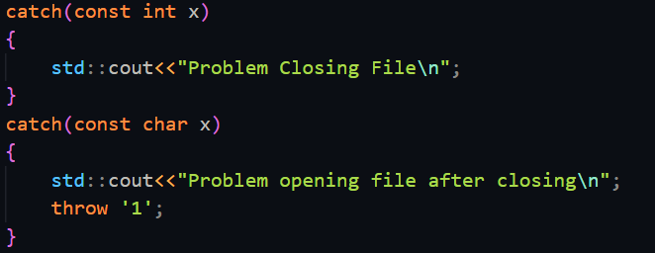
Exception Handling
Exception handling has been used where ever we have closed or opened a file.

Slide 17
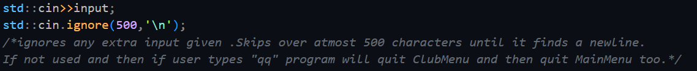
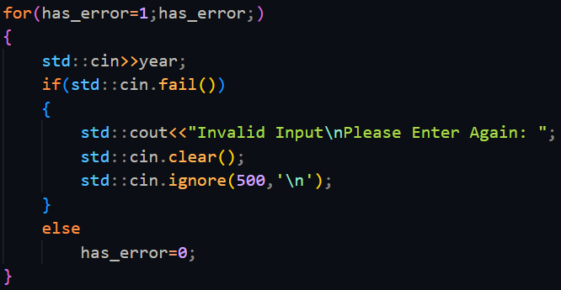

General Error Handling
Usage of checking fail-bit using std::cin::fail method whenever wrong input is given. E.g. inputting a character when an integer was asked to be inputted.
Using std::cin::ignore to ignore extra input given when traversing menus.
Using std::cin::ignore to remove ‘\n’ from the input buffer when taking input using std::getline.
Using std::fstream::clear to remove fail bit after checking for closed file.

Slide 18
General Working
Taking example of Events,
First the “event.txt” file is opened.
Then a Event object is created by reading the file and the object is then pushed into “event_holder” vector.
This is done till end of file is reached.
Then the details of the events in the vector are displayed.
Afterwards the file is closed.

Slide 19
When in Admin Menu,
New Events are added by first taking input from the user and creating a temporary object from it .
The object is then added to the vector.
The file is closed and then reopened (with the ios::trunc flag) .
The members of the objects of the vector are written to the file and flushed.
Events are edited in a similar manner.
Events are deleted using the erase method of std::vector.
After performing these operations the vector is written to the file and the file stream is flushed.

Slide 20
Q/A
Ask us any questions!

Slide 21
Thank you!

